Slide 1
HOSPITAL MANAGEMENT ANALYSIS
BY
AARTHI KRISHNAN

Slide 2
OBJECTIVE
The primary objective of analyzing a Hospital Management System using SQL and Power BI is to efficiently manage healthcare data, streamline hospital operations, and support informed decision-making through data-driven insights. The analysis focuses on transforming complex healthcare data into meaningful reports that improve patient care, operational efficiency, and resource utilization.

Slide 3
KPI Metrics
TOTAL UNIQUE PATIENT
APPOINTMENT COUNT
COMPLETION AND CANCELLATION STATUS BY EACH DOCTOR
SINGLE AND REPEATED PATIENT
TOP 5 BOOKING HOURS
TOP 3 PATIENT BY VISIT COUNT
TARGET VS APPOINTMENT COUNT PER EACH DAY

Slide 4
ANALYSIS
Dr. Michael Johnson – Cardiologist
Dr. Jane Smith – pediatrician
Dr. John Doe – General Physician
Cancellation Status
All appointment made with Michael Johnson is cancelled while other doctor has no cancellation status
Completion Status
Dr. Jane Smith has 100% of Completion Status

Slide 5
Dr. John Doe (General Physician) has the maximum number of appointment but not completed status.
PATIENT VISIT
Single visit of patient count is more than the repeated patient count
The age group between 20-35 has made the maximum appointment in hospital. In which Dr. John Doe has the maximum appointment count .
Patient with ID –P0009(David Lee) has not made even a single appointment with any doctor

Slide 6
BOOKING HOURS
Top appointment booking hours differs for each doctor
AVERAGE WAITING HOUR
The over all average waiting gap between each appointment for each doctor is around 1 hour

Slide 7
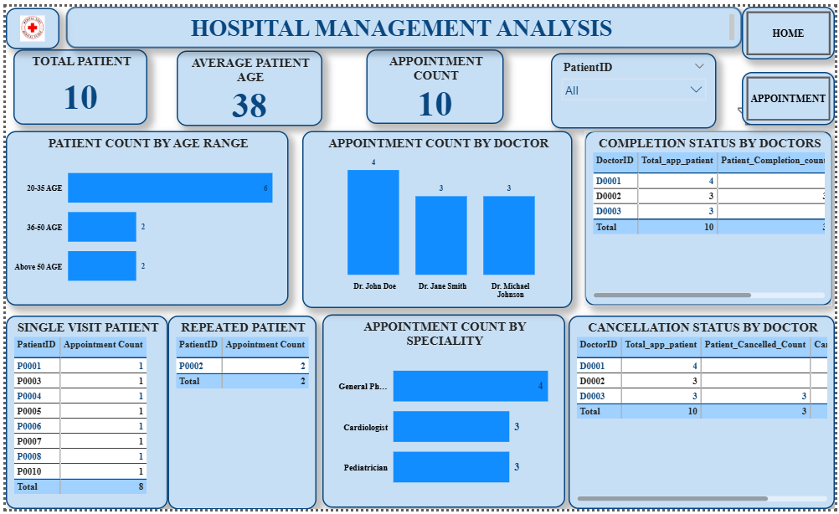

Slide 8
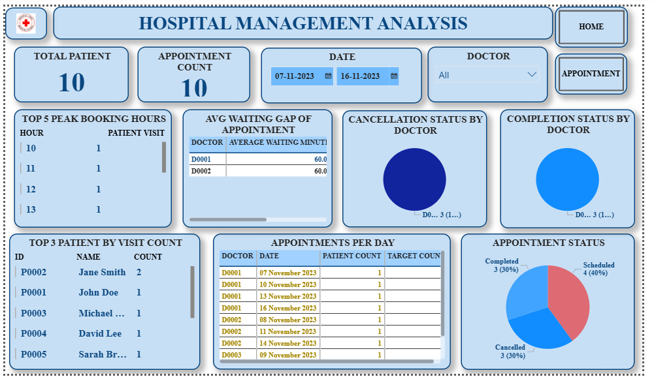

Slide 9
THANK YOU

